Slide 1
New Wheels
New Wheels Quarterly Business Report: Reflecting on our commitment to providing exceptional pre-owned vehicles and unparalleled customer service. Discover key insights and trends that drive our success, from listing to after-sales feedback, in our latest quarterly business report.

Slide 2
Business Snapshot
Total Orders
1000
Total Revenue
Total Customers
Average rating
83,115,001.11
1000
3.1350
Last Quarter Revenue
Last Quarter Orders
Average Shipping Days
% Good Feedback
15,280,009.98
199
97.9640
21.50000

Slide 3
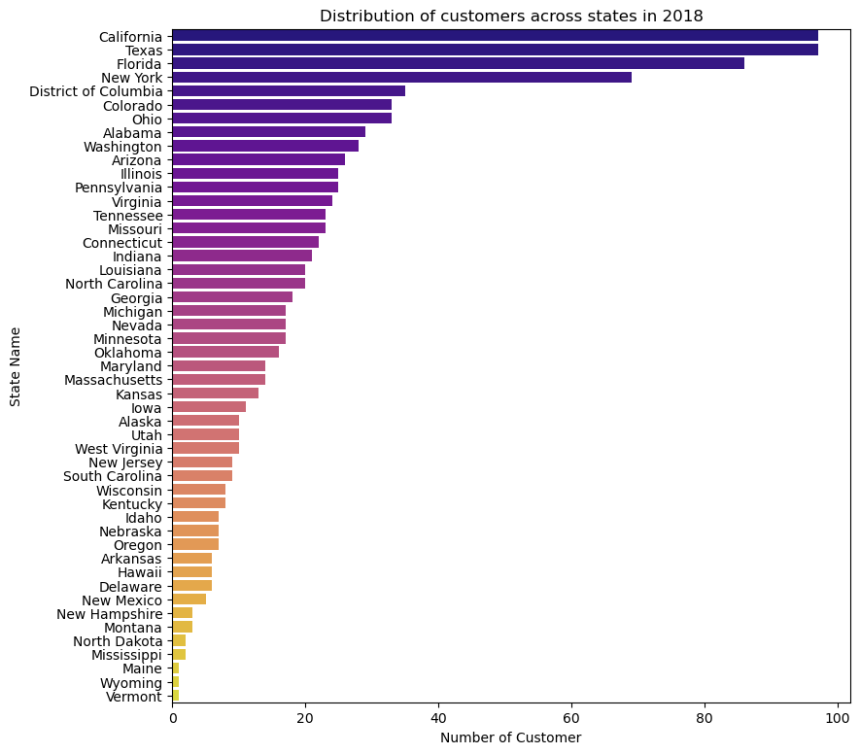
What is the distribution of customers across states?
In our recent business analysis, we observed a dynamic distribution of customers across states. California and Texas lead the count with 97 customers each, followed by Florida with 86. Notably, the District of Columbia boasts 35 customers, while Vermont, Wyoming, and Maine each hold 1 customer. This insightful data aids our strategic planning to cater effectively to regional demands.

Slide 4
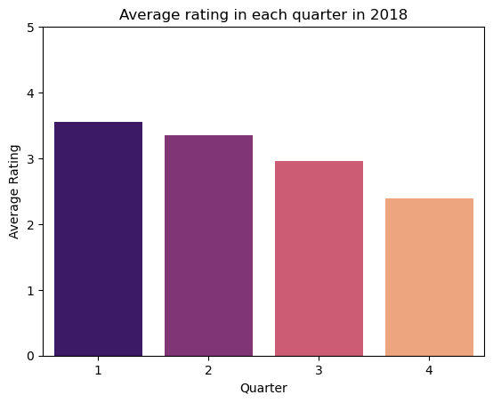
What is the average rating in each quarter?
In our meticulous quarterly analysis, a dramatic plummet in customer ratings reverberates across the expanse of 2018. Quarter 1 recorded the relatively highest rating of 3.5548, while quarter 4 saw the lowest rating of 2.397. This dynamic rating trend provides valuable insights into customer satisfaction dropping over the course of the year, guiding our strategies for continuous improvement.

Slide 5
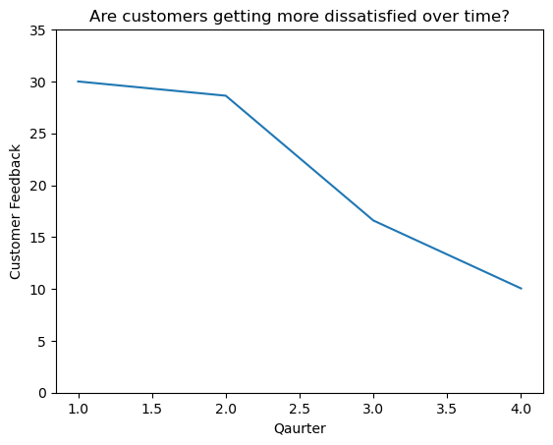
Are customers getting more dissatisfied over time?
Examining the quarterly feedback for 2018, a notable pattern emerges. Starting strong at 30% in Q1, customer satisfaction gradually declines to 28.63% in Q2, further to 16.59% in Q3, and reaches its lowest at 10.05% in Q4. This trend suggests a diminishing satisfaction level over the year, prompting a need for proactive measures to address and improve customer experience.

Slide 6
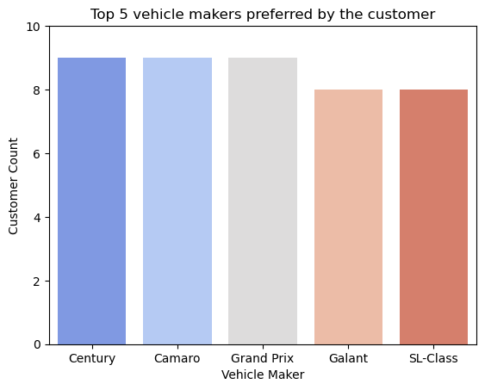
Which are the top 5 vehicle makers preferred by the customer?
Presenting a snapshot of customer preferences, our analysis reveals a unique trio of vehicle models—Century, Camaro, and Grand Prix—each garnering 9 customers. Galant and SL-Class closely follow with 8 customers. This data accentuates distinct customer choices and offers insights into potential areas of focus for enhanced offerings and marketing strategies.

Slide 7
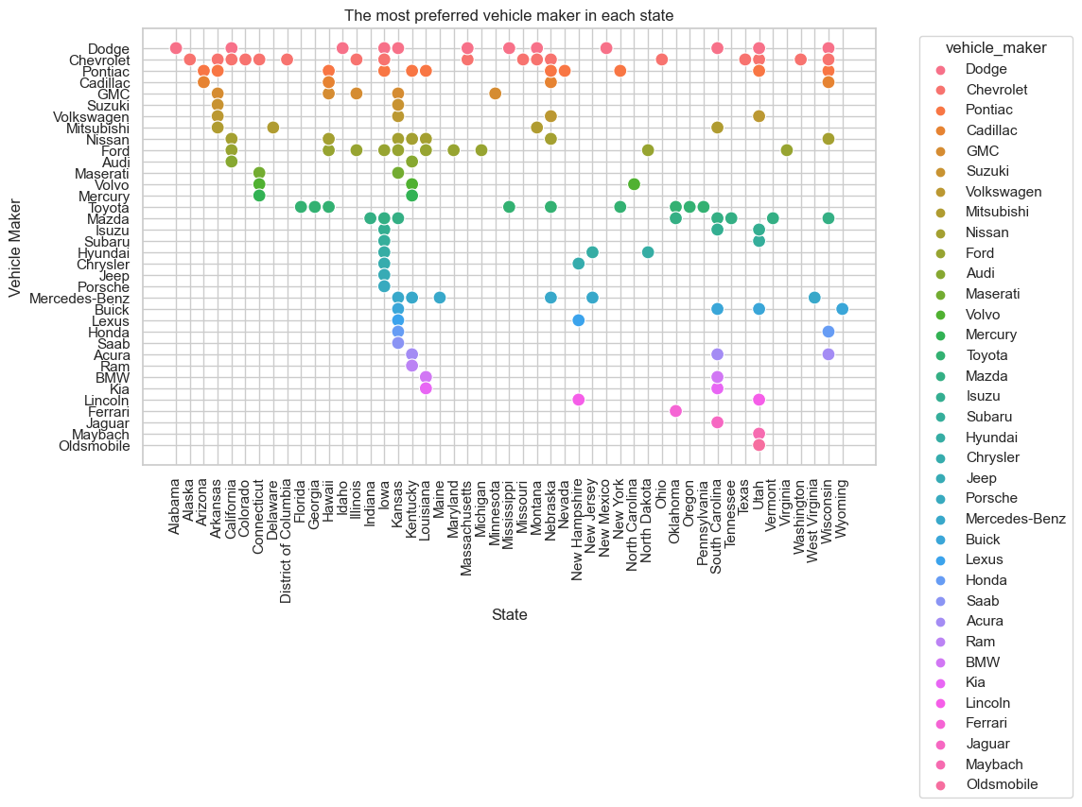
What is the most preferred vehicle make in each state?
Unveiling regional vehicle preferences, our analysis identifies Chevrolet as the preferred choice across various states. With a diverse range of makes, Chevrolet dominates in numerous regions including Alaska, Arkansas, Wisconsin, and more. This insight shapes targeted strategies for tailoring offerings to meet customer demands and bolstering market presence.

Slide 8
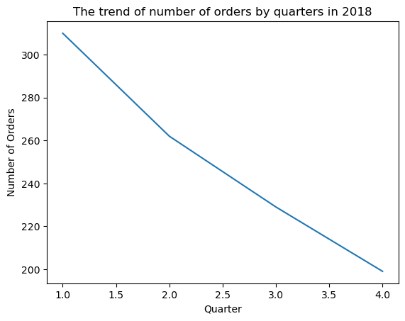
What is the trend of number of orders by quarters?
Analyzing order dynamics across 2018, a discernible trend emerges. Quarter 1 initiated with a strong 310 orders, followed by a gradual decline to 262 in Q2, further reducing to 229 in Q3, and ending at 199 in Q4. This data guides strategic planning to maintain consistency and capitalize on peak quarters for optimal business outcomes.

Slide 9
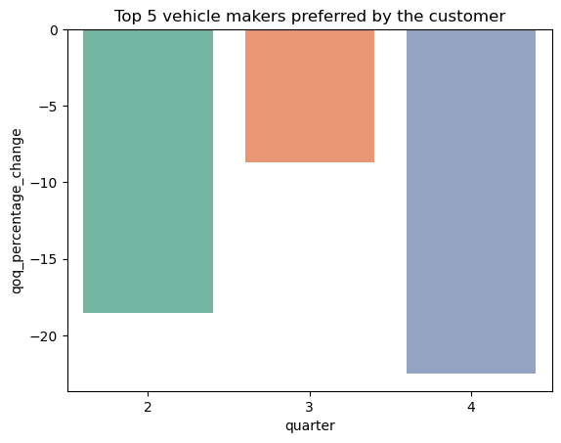
What is the quarter over quarter % change in revenue?
Delving into revenue dynamics, the analysis unveils a consistent pattern of change. Quarter 2 generated $21,595,874.35, experiencing an 18.57% decline from the preceding quarter. Quarter 3 followed with $19,719,917.59, reflecting an 8.69% dip from Q2. The final quarter, Q4, recorded $15,280,009.98, indicating a significant 22.51% decrease from Q3. These insights shape our strategies for responsive revenue management.

Slide 10
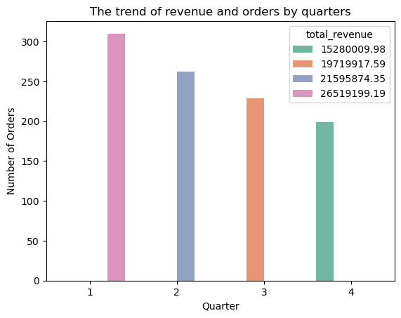
What is the trend of revenue and orders by quarters?
Unveiling the synergy between revenue and orders, our analysis showcases a dynamic pattern. Q1 led with 310 orders, generating $26,519,199.19. Q2 followed with 262 orders and $21,595,874.35. Q3 continued with 229 orders and $19,719,917.59. Q4 concluded at 199 orders and $15,280,009.98. There is a serious dip in number of orders and total_revenue. These findings drive our focus on strategic revenue enhancement.

Slide 11
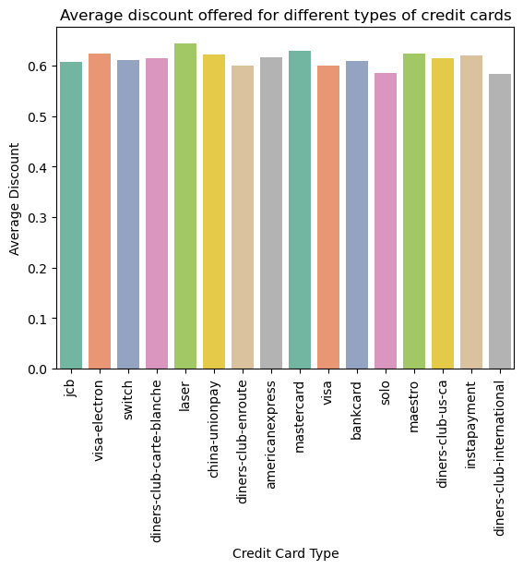
What is the average discount offered for different types of credit cards?
Revealing credit card insights, our analysis unveils diverse average discounts. Notably, 'laser' leads at 0.643846, followed by 'visa-electron' and 'maestro' at 0.623469 and 0.624219. Meanwhile, 'diners-club-international' and 'solo' show lower averages of 0.584000 and 0.585000. These insights inform our tailored discount strategies, elevating customer engagement and loyalty efforts.

Slide 12
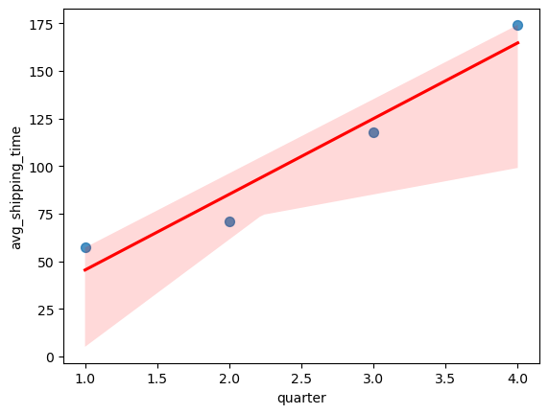
What is the average time taken to ship the placed orders for each quarters?
Unveiling the average shipping times per quarter, our analysis highlights a distinctive pattern. Quarter 1 marked a relatively swift shipping time of 57.1677 days, followed by a slight increase to 71.1107 days in Q2. The trend took a significant leap in Q3, with an average shipping time of 117.7555 days, and further increased to 174.0955 days in Q4. These insights guide our focus on enhancing efficiency in shipping processes.

Slide 13
Insights & Recommendations
Addressing regional disparities is crucial. While California, Texas, and Florida thrive with customers, smaller states like Vermont, Wyoming, and Maine need attention. Implement targeted marketing and support strategies to ensure balanced growth across all states.
After observing a dip in good customer rating, investigate the factors behind the declining ratings, such as product quality, customer support, or changes in offerings. Implement targeted measures to address these issues, focusing on enhancing quality, support responsiveness, and communication to prevent further satisfaction erosion. Regularly monitor feedback to ensure ongoing improvement.
Recognizing the popularity of vehicle models like Century, Camaro, and Grand Prix among customers, further optimizing their features, availability, and marketing could lead to even greater success. Additionally, understanding the factors behind the slightly lower preference for Galant and SL-Class can guide improvements for these models to align with customer preferences.

Slide 14
Insights & Recommendations
The 2018 decline in orders, from 310 in Q1 to 199 in Q4, could stem from changing market dynamics, economic shifts, competition, possible dissatisfaction, evolving preferences, and marketing gaps. Addressing these via strategic adjustments, better engagement, and targeted marketing can stabilize performance and prevent future declines.
The significant decline in both order volume and total revenue throughout the year suggests a critical need to address this downturn. Improving strategies to boost order numbers and increase revenue generation is paramount, necessitating a holistic approach encompassing marketing, customer engagement, and product offerings to reverse this negative trend.
The notable increase in average shipping times over the quarters, particularly the significant jump from 71.1107 days in Q2 to 174.0955 days in Q4, underscores the urgency to streamline and expedite the shipping processes. Improving shipping efficiency across all quarters should be a high priority to enhance customer satisfaction and operational effectiveness.

Slide 15
Thank you!

